Slide 1
Teaching Plan Problem Solving
Search1: Classification of Search Problems, Terminology, and Overview
Search2: Problem Solving Agents
Search3: Heuristic Search and Exploration
Search4: Randomized Hill Climbing and Backtracking (not covered in the textbook!)
Search5: Games (will use slide set for Chapter 6 of the author of the textbook; kind of short)
Search6: Constraint Satisfaction Problems
Search7: Likely more on Greedy Search and A*.
Search8: Information and Discussion of Problem Set1
EC1: Introduction to Evolutionary Computing (EC) / Genetic Algorithms (GA)
EC2: Using EC to Solve Travelling Salesman Problems
A

Slide 2
Classification of Search Problems
State Space Search
Constraint Satisfaction
Problems
Optimization
Problems
Search
Uninformed Search
Heuristic Search
Notes:
The last technology I like to introduce in today’s presentation are shared ontologies. Shared ontologies are important to standardize communication, and for gathering information from different information sources. Ontologies play an important role for agent-based systems.
Ontologies basically describe...

Slide 3
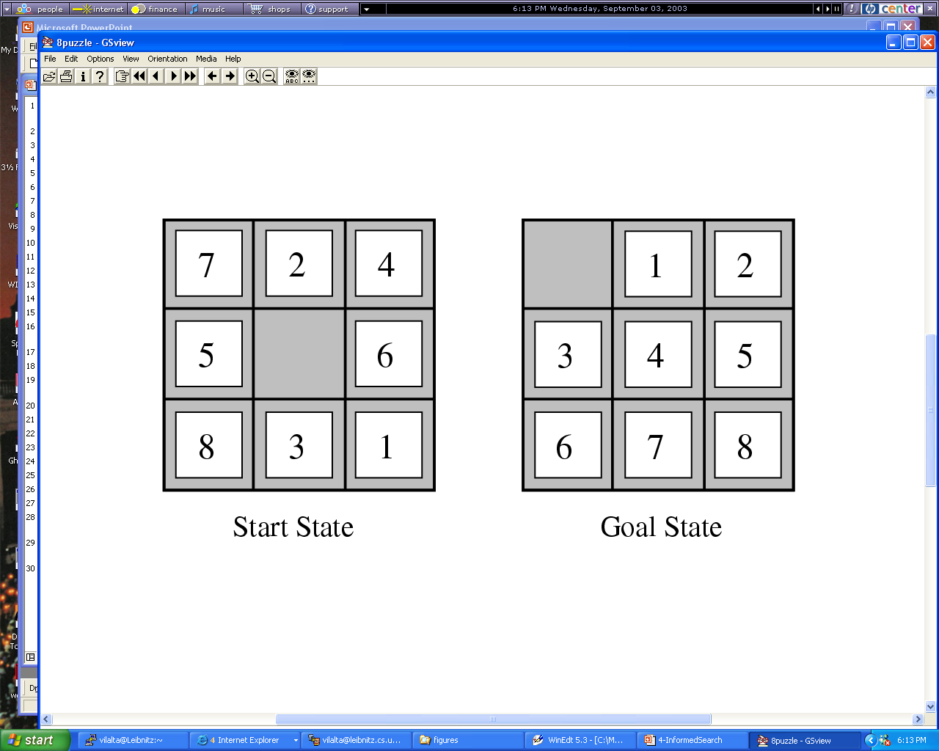
Figure
Example: State Space Search
Goal: find an operator sequence that leads from the start state to the goal state
State Space: a 3x3 matrix containing the numbers 1,…,8 and *(empty)
Operators: North, South, East, West

Slide 4
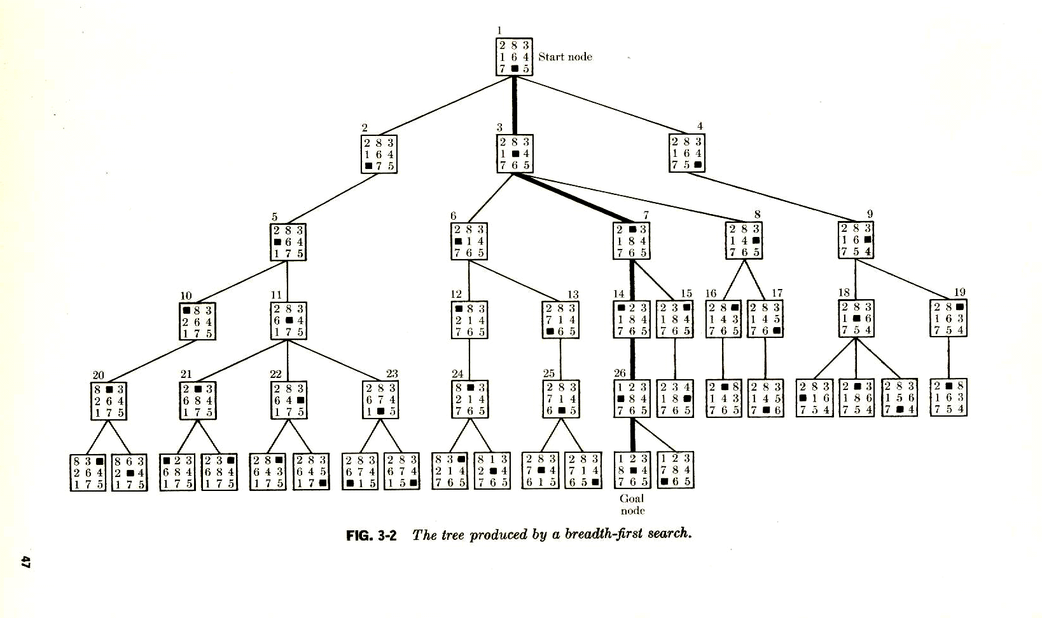
A Search Tree for the 8-Puzzle
Space Complexity: O(n)=O(b**(d+1)

Slide 5
Optimization Problems
Maximize f(x,y,z)=|x-y-0.2|*|x*z-0.8|*|0.3-z*z*y|
with x,y,z in [0,1]
Characteristics:
No explicit operators
the path that leads to the solution is not important
Frequently involves real numbers → number of solutions is not finite
Problems might be complicated by additionally requiring that the solution satisfies a set of contraints.
Life is easier if the function is continuous and differentiable → e.g. classical numerical optimization techniques can directly be applied
AI and evolutionary computing are more attractive for “nasty” optimization problems.

Slide 6
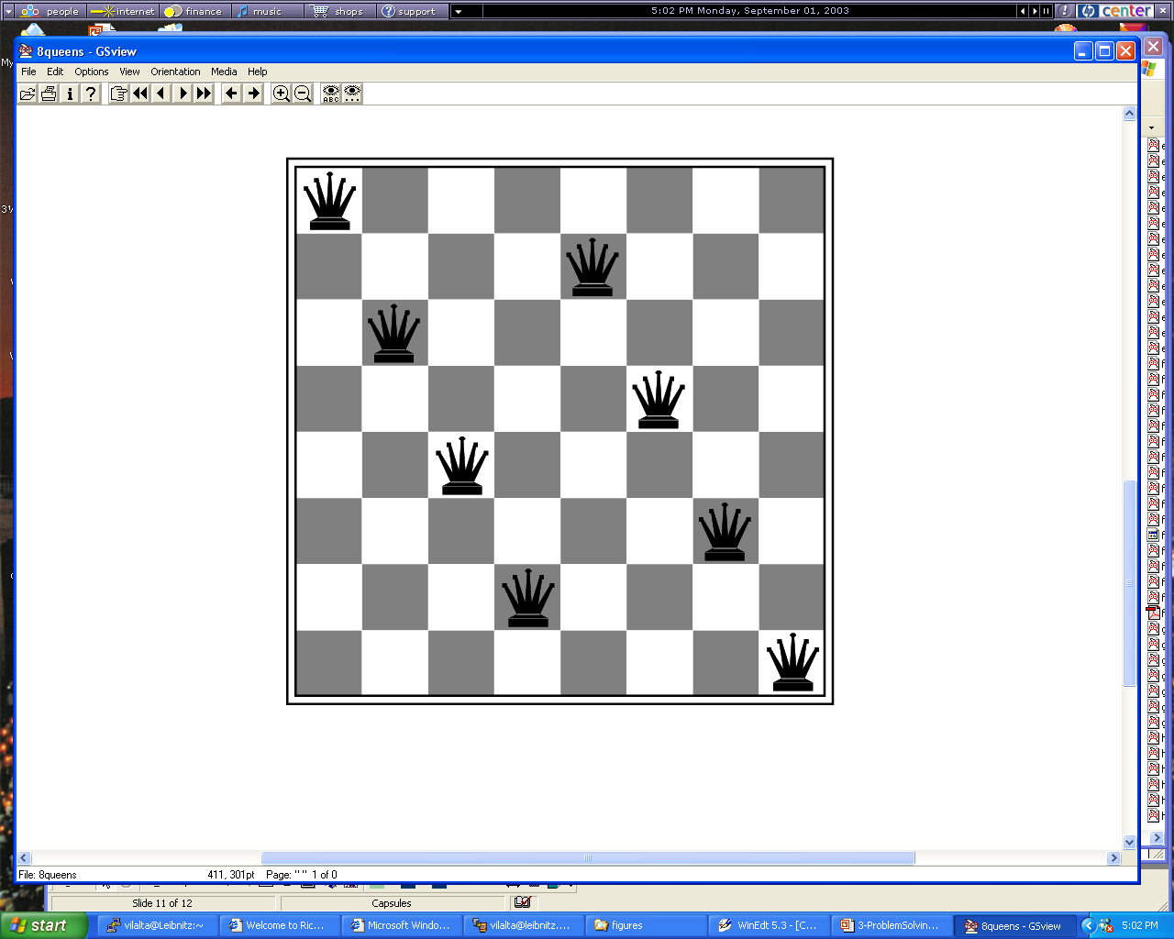
Constraint Satisfaction Problems
http://www.cis.temple.edu/~ingargio/cis587/readings/constraints.html
Find q1=(x1,y1),…,q8=(x8,y8) such that constraint_satisfied.

Slide 7
Heuristic Search
augment
General Search
Algorithms
Domain-specific
Knowledge
Notes:
The last technology I like to introduce in today’s presentation are shared ontologies. Shared ontologies are important to standardize communication, and for gathering information from different information sources. Ontologies play an important role for agent-based systems.
Ontologies basically describe...

Slide 8
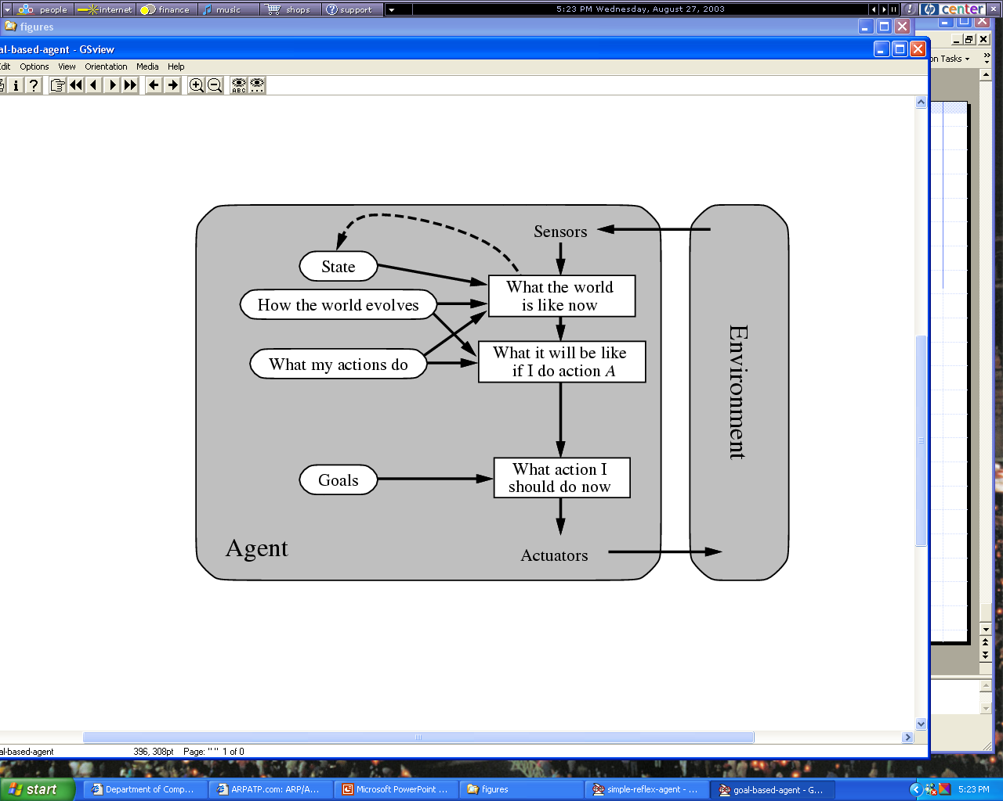
Figure 2.13

Slide 9
Classification of Search Algorithms
State Space Search
Backtracking
Expansion Search
Hill Climbing
Breadth First
Depth
First
Best First Search
Uniform Cost
A*
Greedy Search
Remark: Many other search algorithms exist that do not appear above
Notes:
The last technology I like to introduce in today’s presentation are shared ontologies. Shared ontologies are important to standardize communication, and for gathering information from different information sources. Ontologies play an important role for agent-based systems.
Ontologies basically describe...

Slide 10
Characterization of
State Space Search Algorithms
A search strategy consists of the following:
A state space S, set of operators O: S→S, an initial state, and a (set of) goal state(s).
A control strategy that determines how the search space will be searched; it consists of an operator selection and state selection function:
  Operator selection function: selects which operator(s) is (are) applied to a given state
  State selection function: selects the state to which an operator (selected by the operator selection function) is applied next.
Remarks: Operator selection functions only return operators that have not been applied yet, and state selection functions return only states that have not been completely expanded yet (some applicable operators have not been applied to this state yet); moreover, we assume that ties are broken randomly.
Notes:
The last technology I like to introduce in today’s presentation are shared ontologies. Shared ontologies are important to standardize communication, and for gathering information from different information sources. Ontologies play an important role for agent-based systems.
Ontologies basically describe...

Slide 11
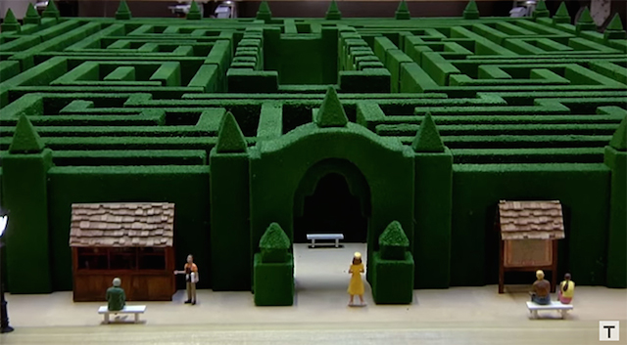
Example: Search Strategies for the
8 Puzzle
Strategy 1 (Breadth First):
Operator Selection Function: select all operators
State Selection Function: Select a state s giving preference to states that are closer to the initial state i(closeness is evaluated by the number of operator applications it took to reach s from i)
Strategy 2 (Backtracking with depth bound set to 3):
Operator Selection Function : Select (applicable) operator by priorities: N>S>E>W
State Selection Function : If the most recently created state is less than 3 operator applications away from the initial state, use this state; otherwise, use the predecessor of the most recent state.
Background: https://en.wikipedia.org/wiki/Ariadne
https://en.wikipedia.org/wiki/Ariadne%27s_thread_%28logic%29
https://en.wikipedia.org/wiki/Labyrinth

Slide 12
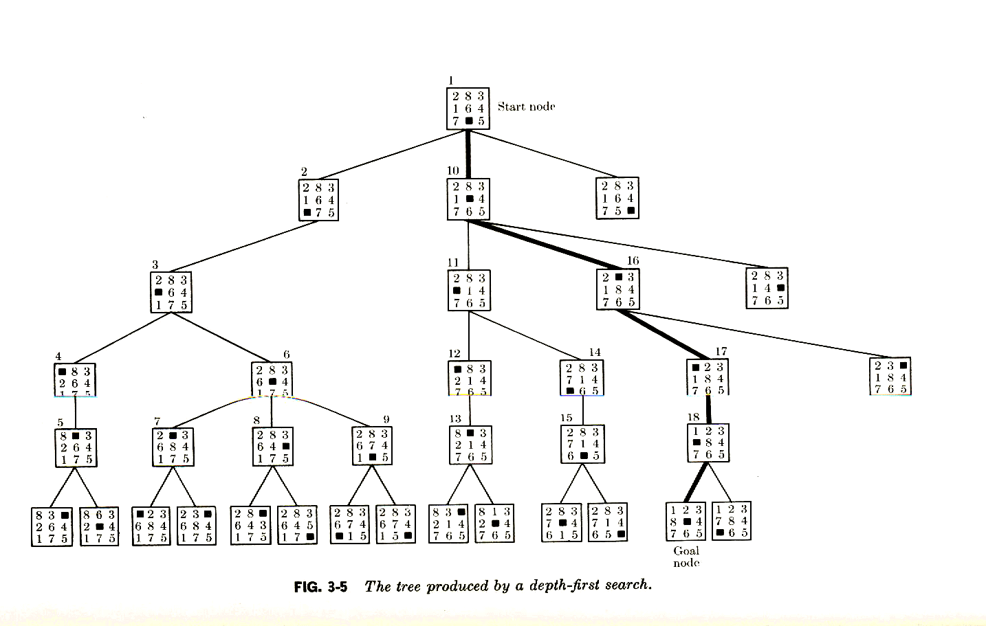
Tree Produced by Depth First Search
Space Complexity Backtracking: O(d)
Space Complexity Expansion Depth-first Search: O(b*d)
Search Graph or Tree??

Slide 13


What happens To People That
Do Not Know Search Strategies
The Shining

Slide 14
Un-graded Homework1 2019
Assume you have to search a labyrinth of interconnected rooms trying to find a particular room that contain a red flower. There will be many intersections of walkways that connect rooms all of which look completely the same; you will not know if you entered a particular crossing before; however, you will be given a piece of chalk that allow you to put signs of your own choosing on a wall. Devise a search strategy that will find a room with a red flower assuming that such a room exists.
To be discussed on February 6, 2019 in class!
Motivation: https://www.youtube.com/watch?v=8P-ALSqmWRI
7:27: shows what happens
you if I you do not know how
to search intelligently…
Goal State

Slide 15
Unlikely also on January 30, 2019
What Does Cooperate America Think about AI?
http://research.google.com/pubs/MachineIntelligence.html (Read!)
http://www.bloomberg.com/news/articles/2015-10-26/google-turning-its-lucrative-web-search-over-to-ai-machines (Video about RankBrain that uses AI)
http://www.zdnet.com/article/beyond-cortana-what-artificial-intelligence-means-for-the-future-of-microsoft/ (Read!)
AI is getting better with time and making our lives easier with Microsoft’s Cortana, Apple’s Siri, Amazon’s Alexa, and Google Now.
IJCAI Homepage
http://ijcai-16.org/index.php/welcome/view/home

